Slide 1

Go, change the world
RV College of
Engineering
ARTIFICIAL INTELLIGENCE AND MACHINE LEARNING
(21AI52)
Unit 5
Department Of Information Science & Engineering

Slide 2
Unit 5
Unsupervised Learning- Overview, What Is Cluster Analysis, Different Types of Clustering’s, Different Types of Clusters
K-means-The Basic K-means Algorithm, Additional Issues, Bisecting K-means, K-means and Different Types of Clusters, Strengths and Weaknesses, K-means as an Optimization Problem
Cluster Evaluation-Overview, Unsupervised Cluster Evaluation Using Cohesion and Separation, Unsupervised Cluster Evaluation Using the Proximity Matrix, Determining the Correct Number of Clusters, Supervised Measures of Cluster Validity, Assessing the Significance of Cluster Validity Measures, Choosing a Cluster Validity Measure

Slide 3
Cluster Evaluation: hard problem
The quality of a clustering is very hard to evaluate because
We do not know the correct clusters
Some methods are used:
User inspection
Study centroids, and spreads
Rules from a decision tree.
For text documents, one can read some documents in clusters.

Slide 4
Cluster evaluation: ground truth
We use some labeled data (for classification)
Assumption: Each class is a cluster.
After clustering, a confusion matrix is constructed. From the matrix, we compute various measurements, entropy, purity, precision, recall and F-score.
Let the classes in the data D be C = (c₁, c₂, …, c_{k}). The clustering method produces k clusters, which divides D into k disjoint subsets, D₁, D₂, …, D_{k}.

Slide 5
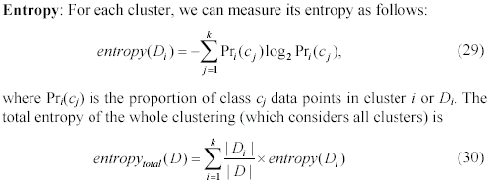
Evaluation measures: Entropy

Slide 6
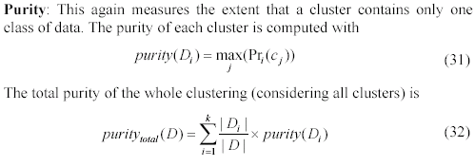
Evaluation measures: purity

Slide 7
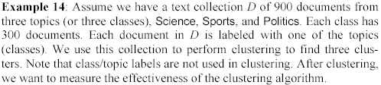
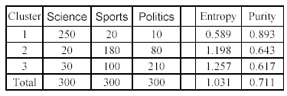
An example

Slide 8
A remark about ground truth evaluation
Commonly used to compare different clustering algorithms.
A real-life data set for clustering has no class labels.
Thus although an algorithm may perform very well on some labeled data sets, no guarantee that it will perform well on the actual application data at hand.
The fact that it performs well on some label data sets does give us some confidence of the quality of the algorithm.
This evaluation method is said to be based on external data or information.

Slide 9
Evaluation based on internal information
Intra-cluster cohesion (compactness):
Cohesion measures how near the data points in a cluster are to the cluster centroid.
Sum of squared error (SSE) is a commonly used measure.
Inter-cluster separation (isolation):
Separation means that different cluster centroids should be far away from one another.
In most applications, expert judgments are still the key.

Slide 10
Indirect evaluation
In some applications, clustering is not the primary task, but used to help perform another task.
We can use the performance on the primary task to compare clustering methods.
For instance, in an application, the primary task is to provide recommendations on book purchasing to online shoppers.
If we can cluster books according to their features, we might be able to provide better recommendations.
We can evaluate different clustering algorithms based on how well they help with the recommendation task.
Here, we assume that the recommendation can be reliably evaluated.

Slide 11
Assessing Clustering Tendency
Assess if non-random structure exists in the data by measuring the probability that the data is generated by a uniform data distribution
Test spatial randomness by statistic test: Hopkins Static
Given a dataset D regarded as a sample of a random variable o, determine how far away o is from being uniformly distributed in the data space
Sample n points, p₁, …, p_{n}, uniformly from D. For each p_{i}, find its nearest neighbor in D: x_{i} = min{dist (p_{i}, v)} where v in D
Sample n points, q₁, …, q_{n}, uniformly from D. For each q_{i}, find its nearest neighbor in D – {q_{i}}: y_{i} = min{dist (q_{i}, v)} where v in D and v ≠ q_{i}
Calculate the Hopkins Statistic:
If D is uniformly distributed, ∑ x_{i} and ∑ y_{i} will be close to each other and H is close to 0.5. If D is highly skewed, H is close to 0
11

Slide 12
Determine the Number of Clusters
Empirical method
# of clusters ≈√n/2 for a dataset of n points
Elbow method
Use the turning point in the curve of sum of within cluster variance w.r.t the # of clusters
Cross validation method
Divide a given data set into m parts
Use m – 1 parts to obtain a clustering model
Use the remaining part to test the quality of the clustering
E.g., For each point in the test set, find the closest centroid, and use the sum of squared distance between all points in the test set and the closest centroids to measure how well the model fits the test set
For any k > 0, repeat it m times, compare the overall quality measure w.r.t. different k’s, and find # of clusters that fits the data the best
12

Slide 13
Measuring Clustering Quality
Two methods: extrinsic vs. intrinsic
Extrinsic: supervised, i.e., the ground truth is available
Compare a clustering against the ground truth using certain clustering quality measure
Ex. BCubed precision and recall metrics
Intrinsic: unsupervised, i.e., the ground truth is unavailable
Evaluate the goodness of a clustering by considering how well the clusters are separated, and how compact the clusters are
Ex. Silhouette coefficient
13

Slide 14
Measuring Clustering Quality: Extrinsic Methods
Clustering quality measure: Q(C, C_{g}), for a clustering C given the ground truth C_{g}.
Q is good if it satisfies the following 4 essential criteria
Cluster homogeneity: the purer, the better
Cluster completeness: should assign objects belong to the same category in the ground truth to the same cluster
Rag bag: putting a heterogeneous object into a pure cluster should be penalized more than putting it into a rag bag (i.e., “miscellaneous” or “other” category)
Small cluster preservation: splitting a small category into pieces is more harmful than splitting a large category into pieces
14

Slide 15
Different Aspects of Cluster Validation
Determining the clustering tendency of a set of data, i.e., distinguishing whether non-random structure actually exists in the data.
Comparing the results of a cluster analysis to externally known results, e.g., to externally given class labels.
Evaluating how well the results of a cluster analysis fit the data without reference to external information.
- Use only the data
Comparing the results of two different sets of cluster analyses to determine which is better.
Determining the ‘correct’ number of clusters.
For 2, 3, and 4, we can further distinguish whether we want to evaluate the entire clustering or just individual clusters.

Slide 16
Measures of Cluster Validity
Numerical measures that are applied to judge various aspects of cluster validity, are classified into the following three types.
External Index: Used to measure the extent to which cluster labels match externally supplied class labels.
Entropy
Internal Index: Used to measure the goodness of a clustering structure without respect to external information.
Sum of Squared Error (SSE)
Relative Index: Used to compare two different clusterings or clusters.
Often an external or internal index is used for this function, e.g., SSE or entropy
Sometimes these are referred to as criteria instead of indices
However, sometimes criterion is the general strategy and index is the numerical measure that implements the criterion.

Slide 17
Measuring Cluster Validity Via Correlation
Two matrices
Proximity Matrix
“Incidence” Matrix
One row and one column for each data point
An entry is 1 if the associated pair of points belong to the same cluster
An entry is 0 if the associated pair of points belongs to different clusters
Compute the correlation between the two matrices
Since the matrices are symmetric, only the correlation between n(n-1) / 2 entries needs to be calculated.
High correlation indicates that points that belong to the same cluster are close to each other.
Not a good measure for some density or contiguity based clusters.

Slide 18
Measuring Cluster Validity Via Correlation
Correlation of incidence and proximity matrices for the K-means clusterings of the following two data sets.
Corr = -0.9235
Corr = -0.5810

Slide 19
Using Similarity Matrix for Cluster Validation
Order the similarity matrix with respect to cluster labels and inspect visually.

Slide 20
Using Similarity Matrix for Cluster Validation
Clusters in random data are not so crisp
DBSCAN

Slide 21
Using Similarity Matrix for Cluster Validation
Clusters in random data are not so crisp
K-means

Slide 22
Using Similarity Matrix for Cluster Validation
Clusters in random data are not so crisp
Complete Link

Slide 23
Using Similarity Matrix for Cluster Validation
DBSCAN

Slide 24
Internal Measures: SSE
Clusters in more complicated figures aren’t well separated
Internal Index: Used to measure the goodness of a clustering structure without respect to external information
SSE
SSE is good for comparing two clusterings or two clusters (average SSE).
Can also be used to estimate the number of clusters

Slide 25
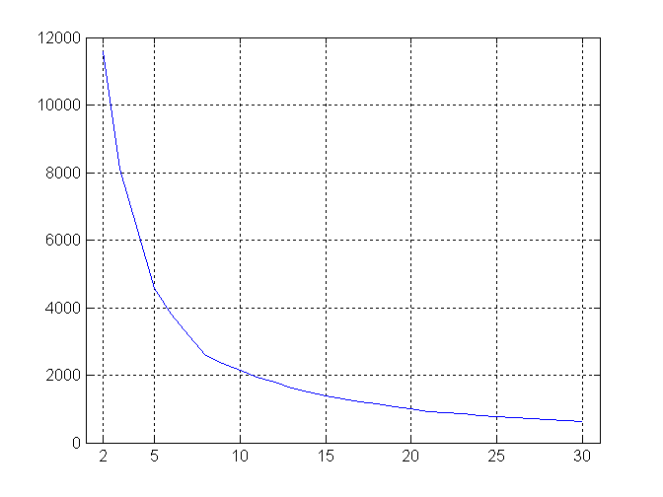
Internal Measures: SSE
SSE curve for a more complicated data set
SSE of clusters found using K-means

Slide 26
Framework for Cluster Validity
Need a framework to interpret any measure.
For example, if our measure of evaluation has the value, 10, is that good, fair, or poor?
Statistics provide a framework for cluster validity
The more “atypical” a clustering result is, the more likely it represents valid structure in the data
Can compare the values of an index that result from random data or clusterings to those of a clustering result.
If the value of the index is unlikely, then the cluster results are valid
These approaches are more complicated and harder to understand.
For comparing the results of two different sets of cluster analyses, a framework is less necessary.
However, there is the question of whether the difference between two index values is significant

Slide 27
Statistical Framework for SSE
Example
Compare SSE of 0.005 against three clusters in random data
Histogram shows SSE of three clusters in 500 sets of random data points of size 100 distributed over the range 0.2 – 0.8 for x and y values

Slide 28
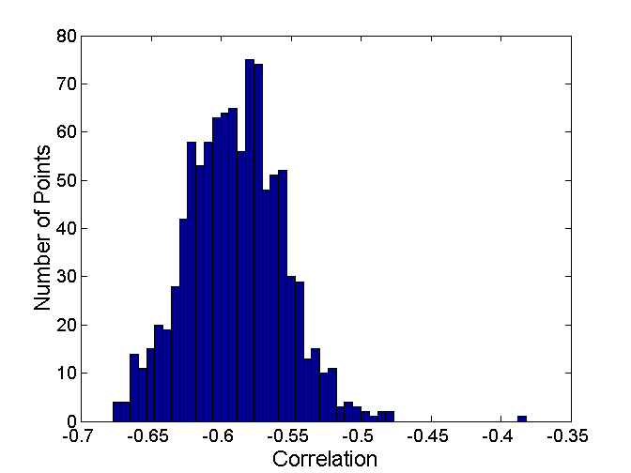
Statistical Framework for Correlation
Correlation of incidence and proximity matrices for the K-means clusterings of the following two data sets.
Corr = -0.9235
Corr = -0.5810

Slide 29
Internal Measures: Cohesion and Separation
Cluster Cohesion: Measures how closely related are objects in a cluster
Example: SSE
Cluster Separation: Measure how distinct or well-separated a cluster is from other clusters
Example: Squared Error
Cohesion is measured by the within cluster sum of squares (SSE)
Separation is measured by the between cluster sum of squares
Where |C_{i}| is the size of cluster i

Slide 30
Internal Measures: Cohesion and Separation
Example: SSE
BSS + WSS = constant
m
×
×
×
1
m₁
2
3
4
m₂
5
K=1 cluster:
K=2 clusters:

Slide 31
Internal Measures: Cohesion and Separation
A proximity graph based approach can also be used for cohesion and separation.
Cluster cohesion is the sum of the weight of all links within a cluster.
Cluster separation is the sum of the weights between nodes in the cluster and nodes outside the cluster.
cohesion
separation

Slide 32
Internal Measures: Silhouette Coefficient
Silhouette Coefficient combine ideas of both cohesion and separation, but for individual points, as well as clusters and clusterings
For an individual point, i
Calculate a = average distance of i to the points in its cluster
Calculate b = min (average distance of i to points in another cluster)
The silhouette coefficient for a point is then given by s = 1 – a/b if a < b, (or s = b/a - 1 if a ≥ b, not the usual case)
Typically between 0 and 1.
The closer to 1 the better.
Can calculate the Average Silhouette width for a cluster or a clustering

Slide 33
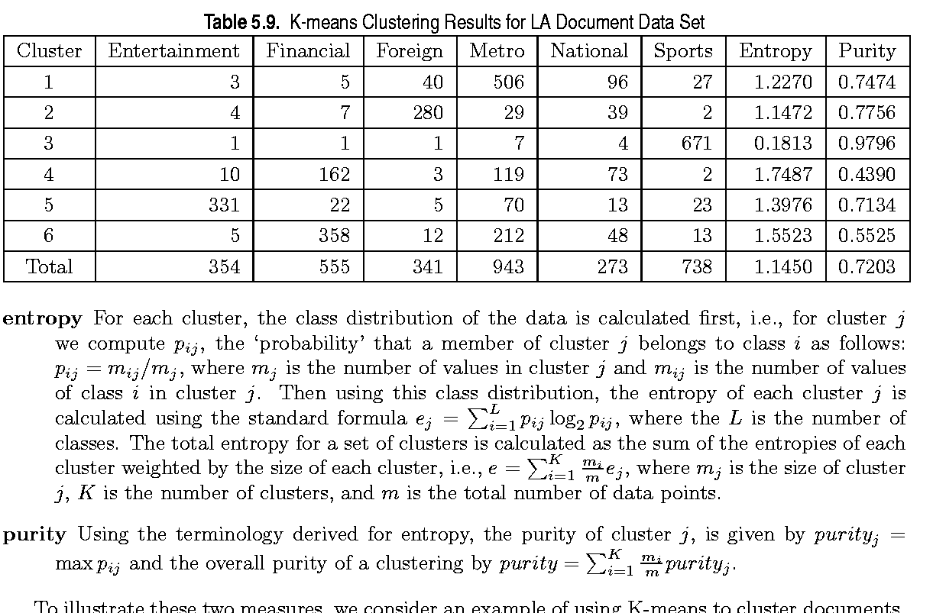
External Measures of Cluster Validity: Entropy and Purity

Slide 34
Final Comment on Cluster Validity
“The validation of clustering structures is the most difficult and frustrating part of cluster analysis.
Without a strong effort in this direction, cluster analysis will remain a black art accessible only to those true believers who have experience and great courage.”
Algorithms for Clustering Data, Jain and Dubes

